Slide 1
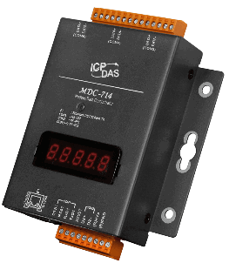
MDC-700 Series
Modbus Data Concentrator
[2016,05,26]

Slide 2
Why You Need
Modbus Data Concentrator?

Slide 3


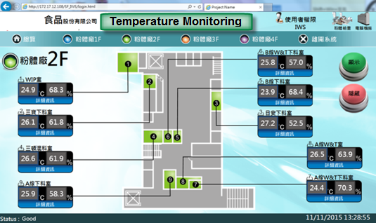
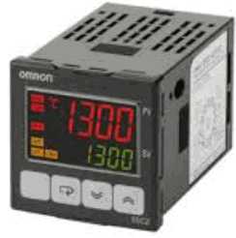
What is the problem?
Most of meters only support low speed serial interface (RS-232 or RS-485)
Discontinuous data collecting makes communication less efficient
Low Speed
RS-485
Data #1
Data #2
Data #3
Data #4
Data #5
Data #6
Notes:
The conventional approach is to read back the data from the meters one by one via RS-485.
However, the speed will be quite slow.
The speed bottleneck of this system is that:
the speed of the RS-485 itself is not fast enough, so even the performance of the PC is enhanced
(such as: upgrade the CPU or increase RAM size), the speed problem still cannot be solved.

Slide 4

What if I need more?
Can I get all device status in one time?
What if I want to share the data to 2nd set of SCADA?

Slide 5
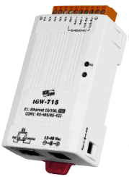
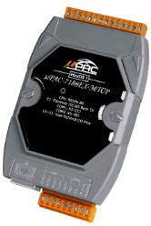
Does Gateway Solve the problem ? No.
High Speed
RS-485
Modbus RTU
Ethernet
Modbus TCP
tGW-715
Data #1
1
Data #2
RS-485
Data #1
Data #2
Data #3
4
Data #3
2
3
uPAC-7186EX-MTCP
Notes:
The gateway products used for“ Modbus/TCP to Modbus/RTU” is quite popular.
We have similar products such as I-7188EX-MTCP, tGW-715, etc.
For this type of product, it is required to setup the baudrate of the COM port on the gateway, and the ID range of the Modbus/RTU devices managed by each COM port.
When performing communication, on the PC, the IP address and Modbus ID of the Gateway are specified; when the commands are sent from the Modbus/TCP to the gateway, they will be bypassed to the Modbus/RTU devices on the corresponding COM port.
The setting of Gateway is quite easy. But when you actually performing the operation, it is required to send the command to each device one by one, so even the PC side already uses Modbus/TCP communication, in the entire process of communication, a part of the communication still being transmitted via RS-232/485 and the speed will be slow down because of that.

Slide 6
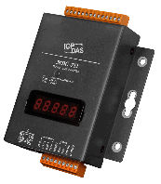
Does MDC Solve the problem ? Yes.
RS-485
MDC-711
1
High Speed
Data #1, #2, #3
Ethernet
T2
T3
2
T1
R1
Data #1
R2
R3
MDC-711
Data #2
Data #3
Notes:
The Modbus Data Concentrator will uses a scan engine to read back the data of Modbus/RTM devices one by one and store the data in the internal memory of the MDC device.
After receiving the Modbus/TCP command sent from the PC, the MDC will then directly send the data stored in its internal memory to the PC.
Therefore, when the PC requires obtaining the data of the Modbus/RTU devices, it can communicate with the MDC through the Ethernet, the communication speed will be fast and all the data stored in MDC can be retrieved immediately at once. By this way, it is much more efficient.

Slide 7
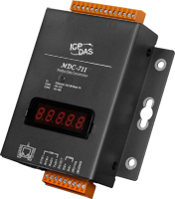
MDC makes register continuous
#1
#2
#1
#2
#3
#4
#3
#4
Notes:
Even, the Modbus data of some RTU devices are not stored continuously.
In the old communication way, the PC will need to send multiple commands to read these data. The communication speed of the RS-232/485 is already slow, if it requires Read/Write the data by several times, the efficiency will be even worse.
The MDC will organize the data from multiple RS-232/485 devices to be stored continuously no matter it is continuous or non-continuous data.
By this way, the PC can read large amounts of data at once and dramatically increases the efficiency of the communication speed.

Slide 8
MDC-700 Series and features

Slide 9
MDC-700 Series
Modbus Data Concentrator
 | MDC-711 | MDC-714 | MDC-741
Ethernet
Port | 1, 10/100 Base-TX
Protocol | Modbus/TCP Slave
COM Port
RS-232 | 1 |  | 4
RS-485 | 1 | 4 | 1
Protocol | Modbus RTU Master/Slave

Slide 10
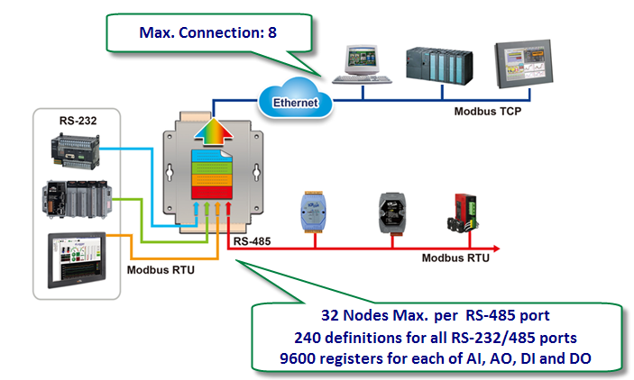
Great Capability

Slide 11
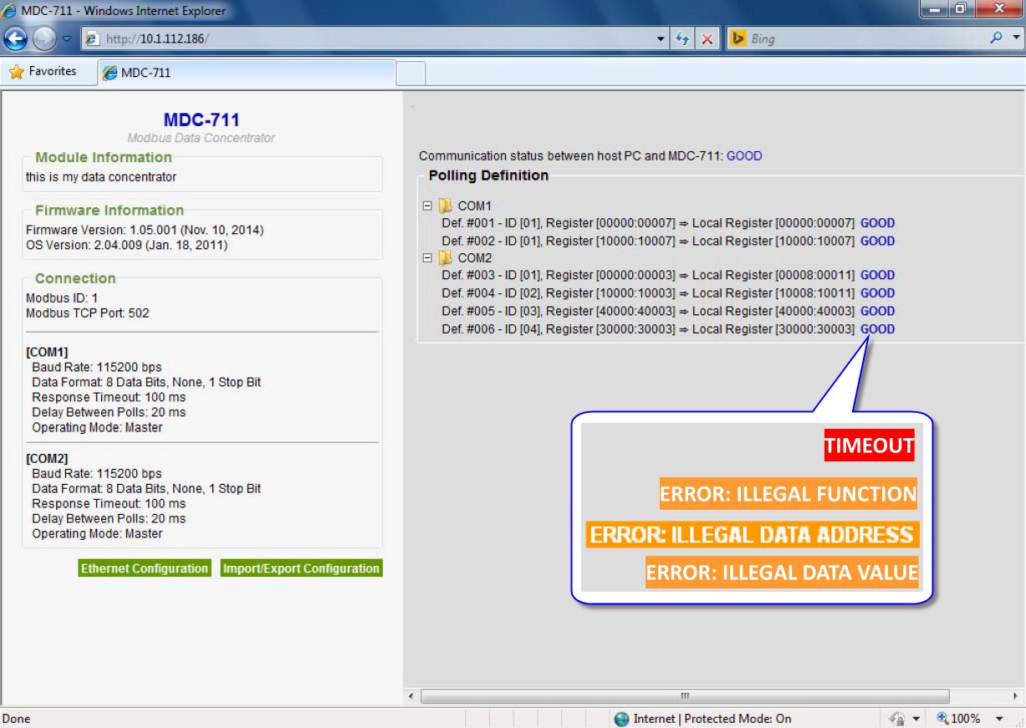
Easy to Use
Web-based User Interface

Slide 12
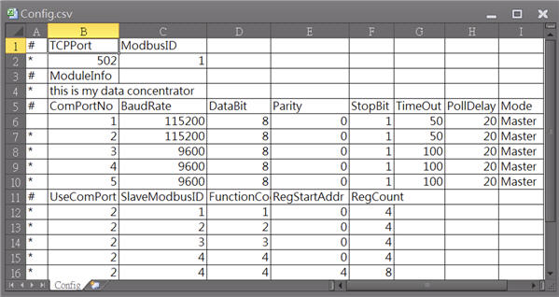
Easy to Use
Configuration with .CSV file

Slide 13
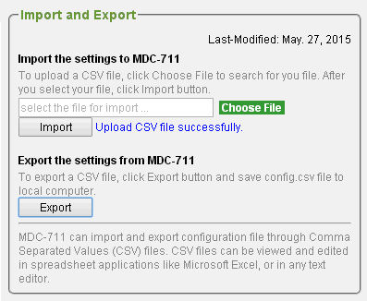
Easy to Use
Import/Export the Config.csv File
Notes:
Config.csv is stored in the MDC-700 and can be quickly copied to another MDC-700 via import/export.

Slide 14
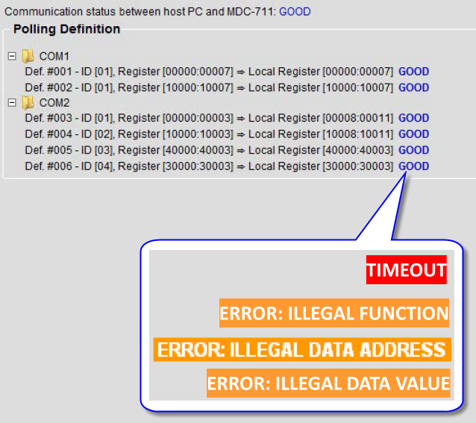
Easy to Use
Easy to know the register mapping address
Easy to know communication result → Easy to Debug
Notes:
You can see each definition on the MDC-700 Web page, and the register mapping address.
The results of each operation can also be found, if there is any communication error, you can quickly find out which Modbus/RTU device fails.

Slide 15
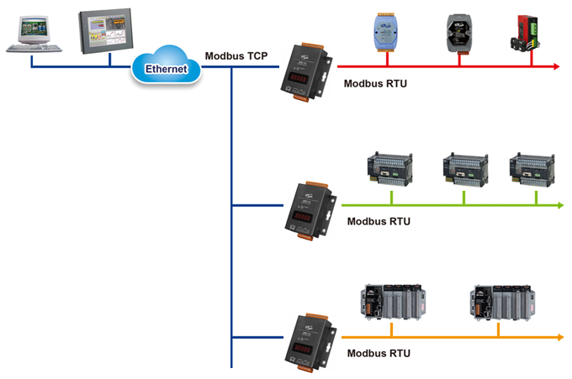
Good Expansion Flexibility
Multi-Ports Selection:
MDC-711: 1x RS-232, 1x RS-485
MDC-714: 1x RS-232, 4x RS-485
MDC-741: 4x RS-232, 1x RS-485
Notes:
Multi-port selection

Slide 16
Similar Products in The Market

Slide 17
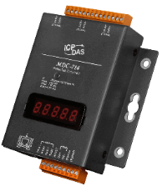
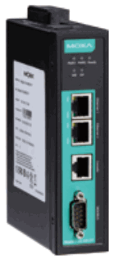

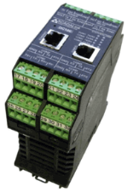
Similar Products
Item | MDC-700 Series | MGate 5150 | MBDC-200 | DC-100
Company | www.icpdas.com | www.moxa.com | www.proconx.com | www.scanlink.com
Configuration Tool | Web | Web, Utility | Web | Utility
COM port | 2~5 | 1 | 2 | 4 (2xRS-232,2x RS-485)
Modbus Commands | 240 | 100 | Not mentioned | Not mentioned
Memory Size | 9600 registers for each table of AI, AO, DI, DO | 2048 input bytes & 2048 output bytes | 8000 bytes for all table | 500 register for all table
Status of communication result | Shown on web page for each definition ⬅ Easy to read and diagnose | Counter for error events | Counter for error events | Not mentioned
Configuration Import/Export | Yes | Yes | Yes | Not mentioned










Notes:
The MDC-700 is the easiest one to use and can handle the maximum amount of data. Depending on the number of COM ports, there are 3 models to choose from, it is the most flexible one.
The MBDC-200 features almost the same functionality and is only second to the MDC-700, but it only has two COM ports.
DC-100 is not easy to use, and the number of the devices it can be connectted to is also the least.
MGate 5150 features lots of functions(Modbus, Ethernet / IP), but it is not easy to use, and it only has one COM port, the scalability is the worst.

Slide 18
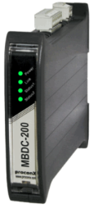
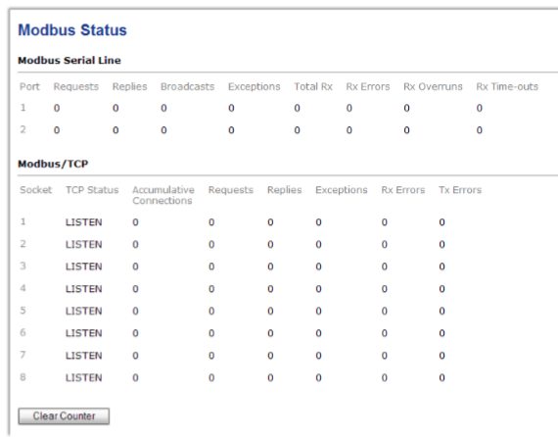
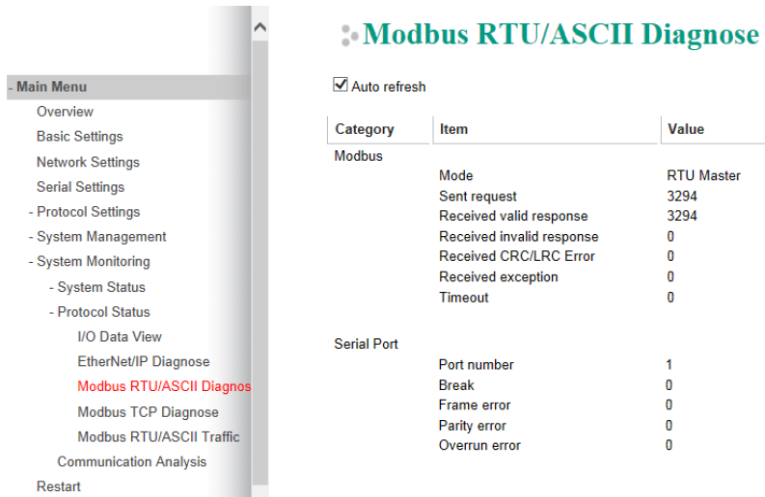
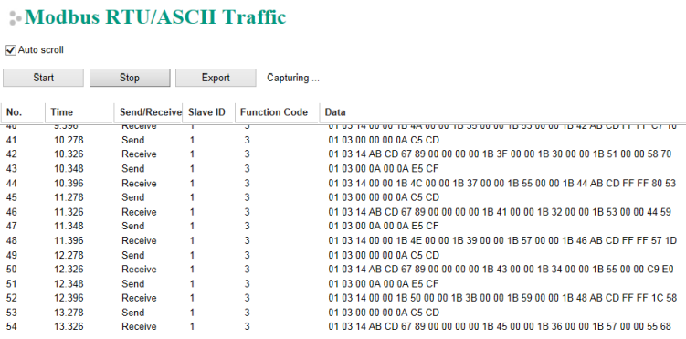
Status of communication result
MDC-700
MBDC-200
MGate5150
Notes:
1. If requires to connect to a lot of Modbus/RTU devices, the software tool must be easy to view so that the results of the operation can be detected immediately.
2. For MBDC-200, it only shows how much error has occurred, but it did not specify which Modbus/RTU device fails, and what kind of error it is, when encountered a problem, it is not easy to Debug.
3. The Mgate 5150 is better than MBDC-200. It features a function to read the original data ofthe Modbus communication, but the original data is quite complex and not easy to read.

Slide 19
MDC-700 Selling Points
Key Benefit
Speed up the time for reading from multiple Modbus/RTU devices
Upgrade Modbus/RTU devices with Ethernet communication ability
Web-based user interface
Easy configuration with .CSV file
Supports the Modbus RTU master and slave
Support for up to 8 Modbus TCP masters
Data pool for up to 9600 registers
Modbus polling commands for up to 240 definitions
Easy to Use
Easy to be Integrated
Great Capability

Slide 20
Choose MDC or Gateway ?
Price: MDC > I-7188EX-MTCP > tGW
Performance Improved: MDC >>> I-7188EX-MTCP = tGW
Notes:
If the number of RS-485 devices is small (<= 5 pcs), the users can select the I-7188EX-MTCP or tGW which are more cost-effective.
However, if the scale of the system is large and uses more RS-485 devices, to use MDC will effectively enhance the overall communication performance.

Slide 21
What is the next for MDC ?
Log for communication failure events
Log for data

Slide 22

Q & A
～Thank You Very Much～

